Slide 1
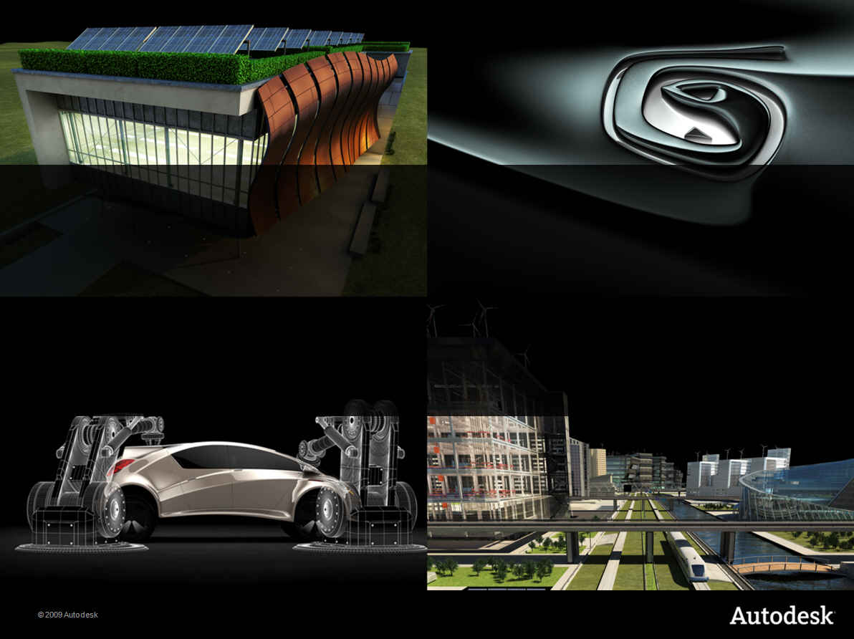
Maya 2011 || What’s New in the API
Kristine Middlemiss, ADN

Slide 2

Maya Sherlock New API Features
Qt
Maya Nucleus™
Improvement on M3dView
Camera Set
Miscellaneous

Slide 3
Welcome to Qt in Maya 2011!
Autodesk Maya 2011 is built upon the Qt UI Toolkit.
This powerful cross-platform toolkit brings with it a wealth of new features and capabilities.
We are extremely excited to bring this new functionality to you!

Slide 4
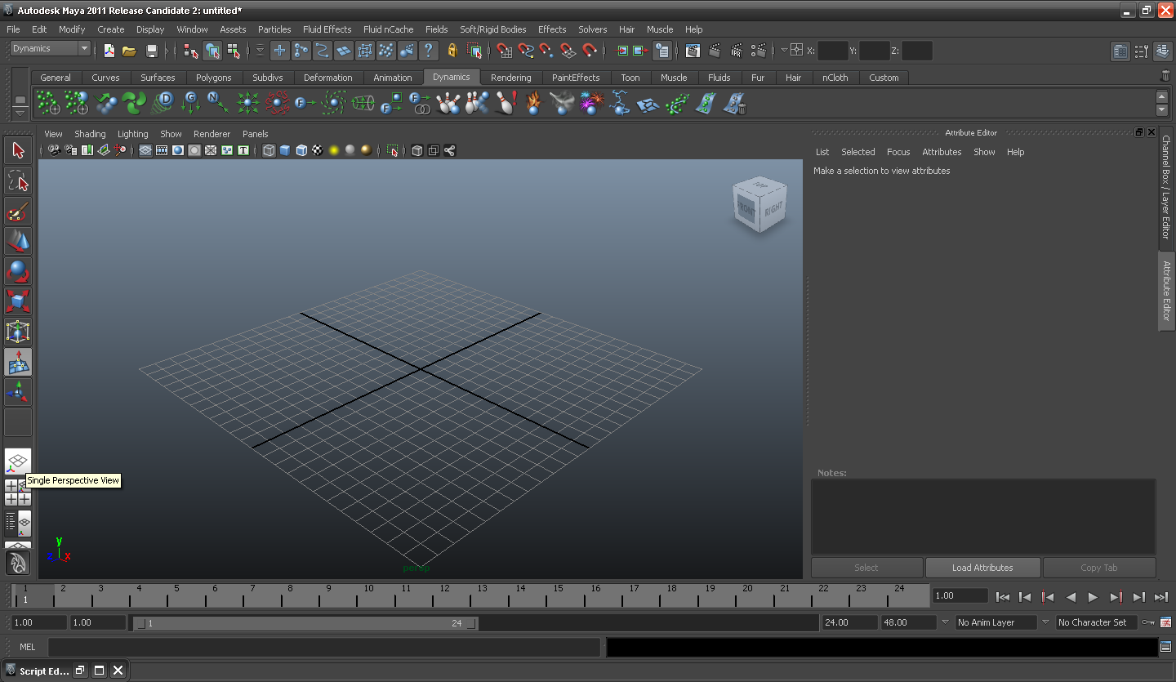
What does it look like?
Brand New Look and Feel!

Slide 5
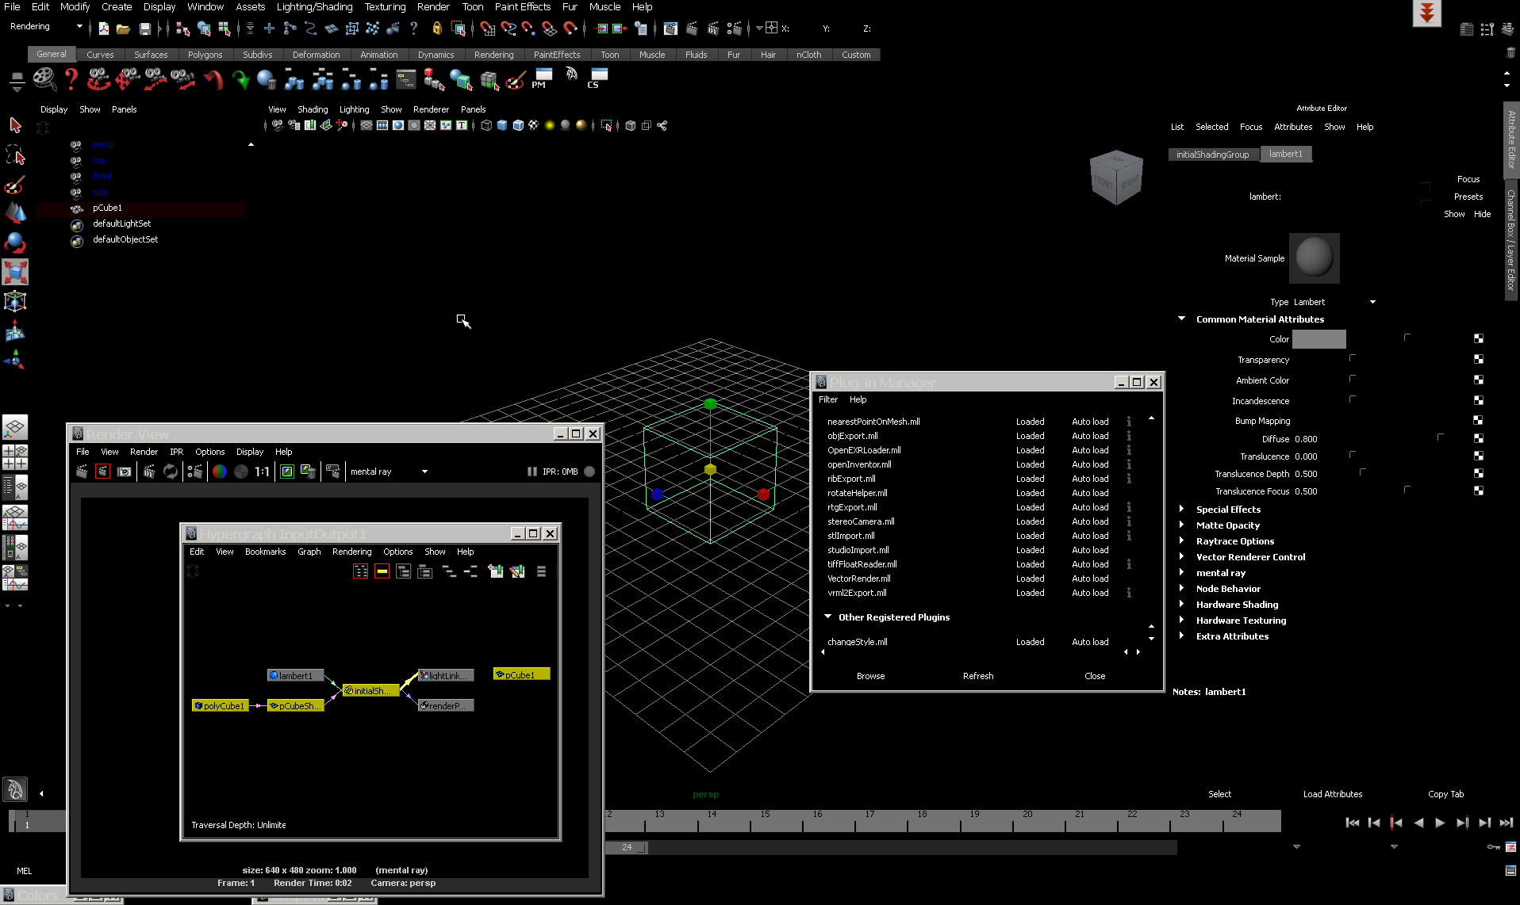
What CAN it look like?
Interesting…

Slide 6
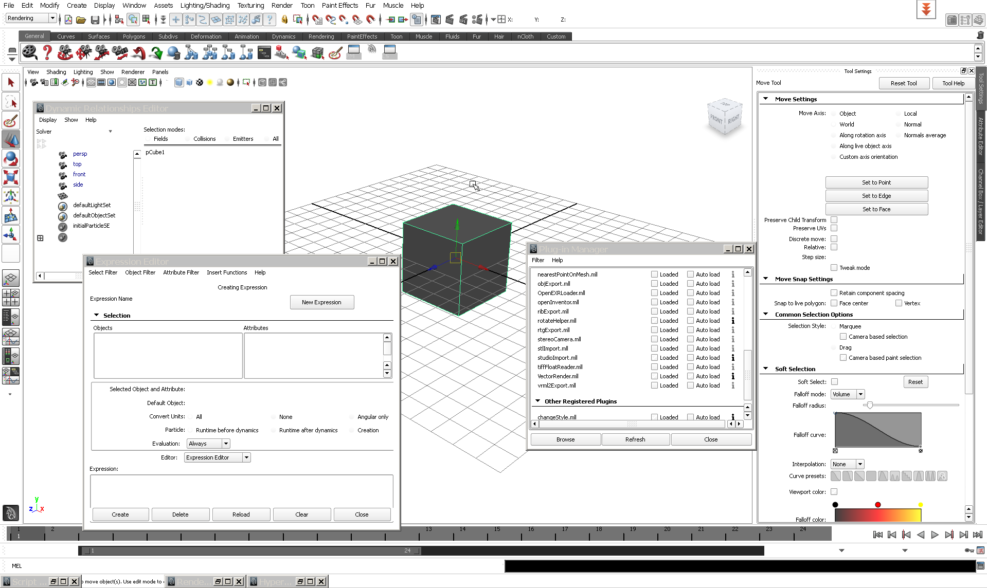
What CAN it look like?
Google and I would get along…

Slide 7
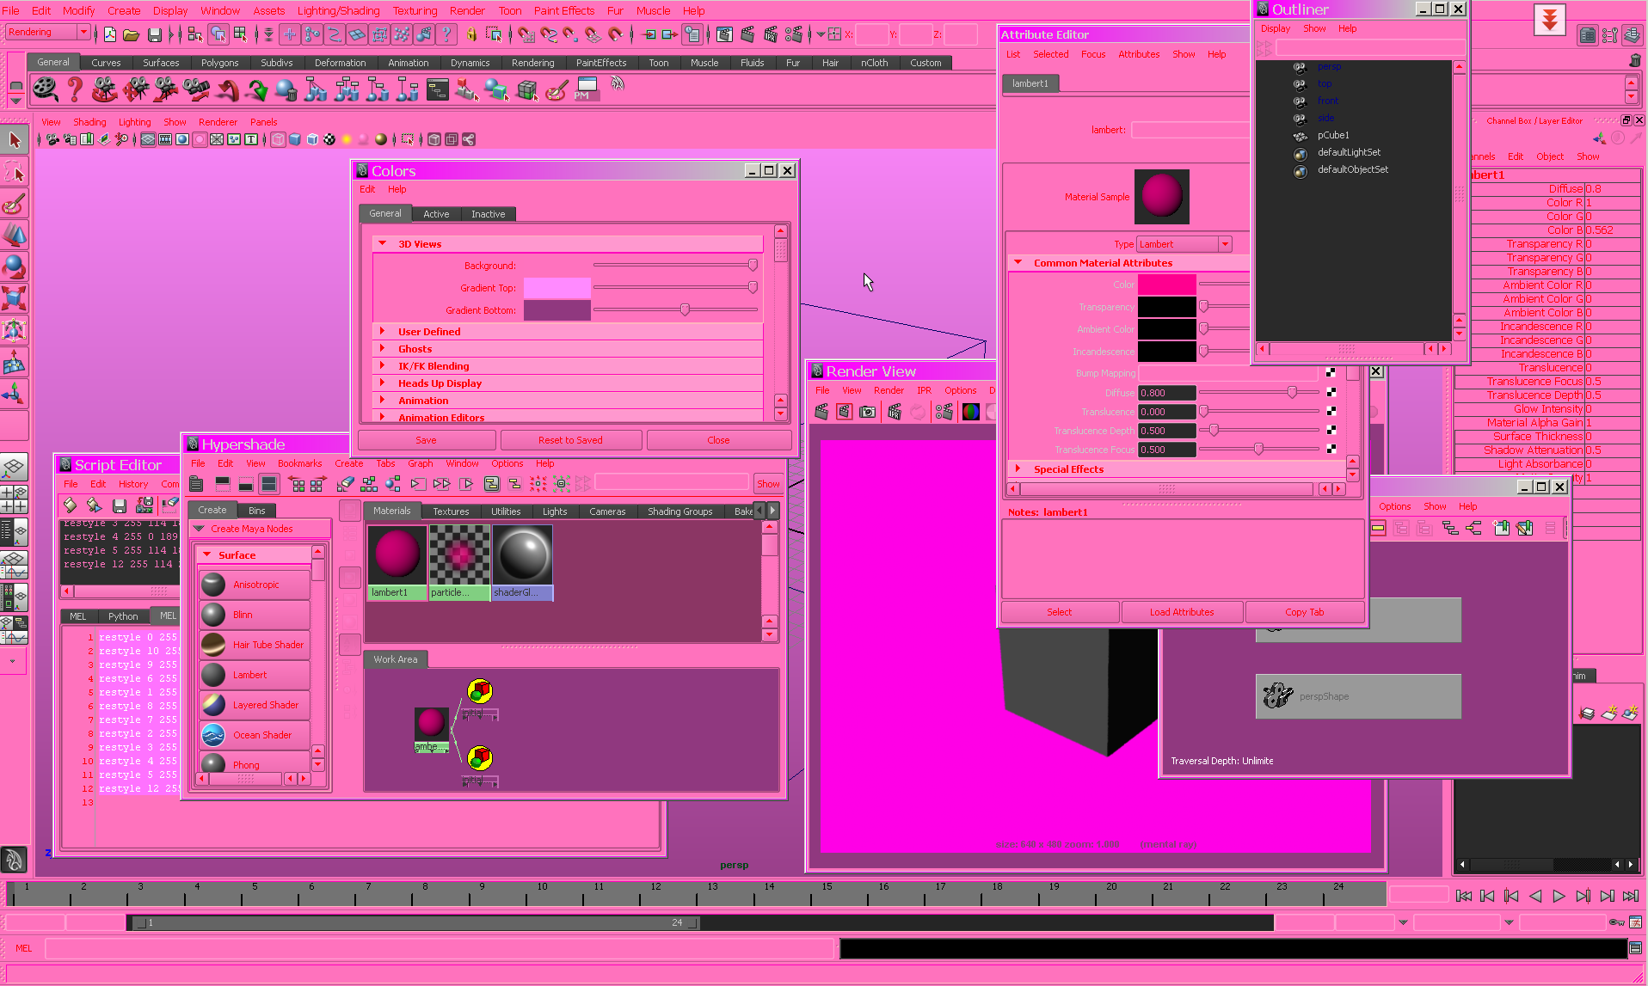
What CAN it look like?
Yikes!!!!!!

Slide 8
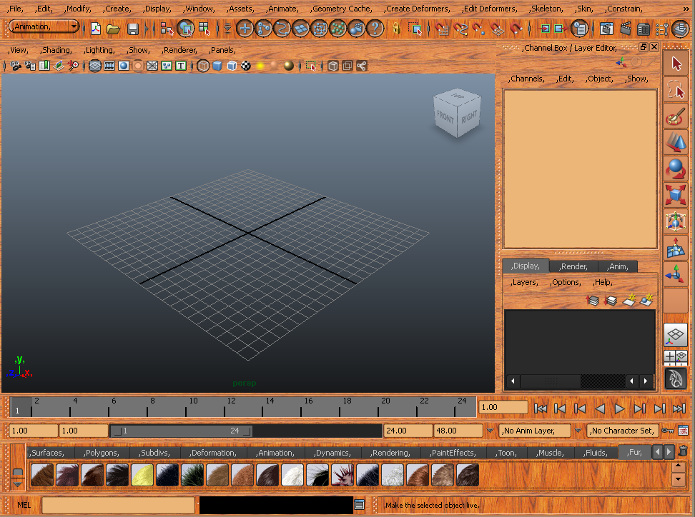
What CAN it look like?
No comment ;)

Slide 9
What does this mean?
Artist
  Customize at your finger tips
Scripter
  Some new MEL commands
API Developer
  This is where the fun begins!

Slide 10
Is MEL Going Away?
NO!!!

Slide 11
How does Qt fit in with MEL?
User View
MEL/Python UI Commands
Internal UI Toolkit
Qt UI Toolkit
Maya Application

Slide 12

Qt (Cute)
Application and GUI framework
Cross-platform
Trolltech bought by Nokia
Qt licensing
  GNU LGPL
  Commercial
Qt is in Maya Sherlock!

Slide 13
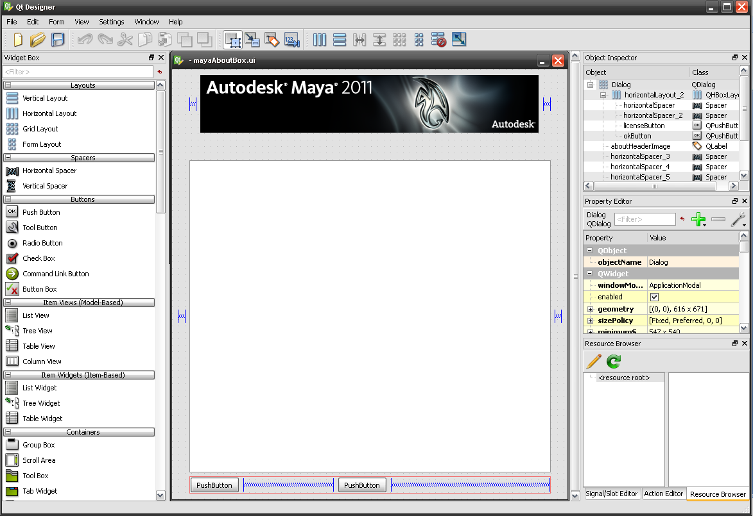
New approach to Interface Design
Qt Designer (demo)

Slide 14
New approach to Interface Design
Qt Designer: *. ui
MEL command: loadUI
string $dialog1 = `loadUI -f "C:/WORK/Project/DevDays -2009/mydialog.ui"`;
showWindow $dialog1;
Advantages
    Easy interface building
    New control added
    More functionality and flexibility: docking windows
Embed MEL/python command
    create dynamic property on widget
    put MEL/python command as a string

Slide 15
Maya API: MQtUtil
  Allow user to look up Maya controls by name and retrieve its Qt pointer
static QWidget* findControl(MString controlName, const QWidget* ancestor);
static QWidget* findLayout(MString layoutName, const QWidget* ancestor );
static QAction* findMenuItem(MString itemName);
static QWidget* findWindow(MString windowName);
static MString fullName(const QObject* uiElement);
static QList<QObject*> getLayoutChildren(const QWidget* layout);
static QObject* getParent(const QObject* uiElement);
static MString toMString(const QString& qstr);
static QString toQString(const MString& mstr);

Slide 16
MQtUtil Class Example
    saveSwatchesCmd : This example takes a list of render node names as arguments and generate a 64*64 JPEG files ( a snapshot of the shader’s swatch) for each one and save them in current directory.

Slide 17
Qt Examples
Other Qt examples in the devkit
    qtForms
    helixQtCmd
No Visual Studio Project
Use Makefile.qt
    Download Qt package
    Launch command prompt window
    Go to devkit/plug-ins directory
    Execute Command: nmake -f Makefile.qt

Slide 18
Demo
    qtForms:
    Example Shows three different methods for creating Qt dialogs from within a plug-in.
    helixQtCmd: helixMotifCmd
    Example demonstrate a very basic window with a button, it draws a helix once you click on the button. It was on linux only.

Slide 19
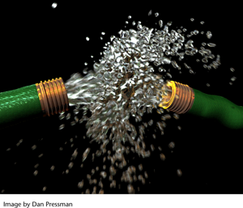
Maya Nucleus™ System
Maya8.5
nCloth
Maya 2008
Maya Nucleus
nConstraint
nParticles
Maya2009

Slide 20
Nucleus API in Maya 8.5
Examples:
      testNObjectNode; testNucleusNode
MnCloth
MFnNObjectData

Slide 21
How Nucleus System Work
time
startState
currentTime
nCloth
Node
currentState
Nucleus
solver
nextState
inputGeom
outputGeom
shape
node
Shape
node
Notes:
Introduction to interacting with the N Solver
=============================================
In order to create an N cloth object that can interact with the Nucleus solver,
your object will need to own a MnCloth, which represents the underlying
N cloth and its data.
your node will also need the following 6 attributes:
ATTR Type Description
startState kNObject initial state of your N object
currentState kNObject current state of your N object
currentTime Time connection to the current time
nextState kNObject next state of you N object
inputGeom kMesh input mesh
outputGeom kMesh output mesh
inputGeom,outputGeom and currentTime are self explanatory.
A connection is to be made from the nucleus solver's outputObjects attribute to
the nextState attribute of your node. Also, you need to connect the currentState
and startState attributes of your node to the inputActive and inputActiveStart attributes
on the solver node respectively.
Once these connections are made, the normal sequence of events is the following:
The refresh will trigger a pull on the output mesh attribute. At this your node will
pull on the nextState attribute, triggering a solve from the solver. Depending on the current
time, the solver will trigger pulls on either the currentState or startState attributes of your
node. If the startState is pulled on, you need to initialize the MnCloth which you node
owns from the input geometry. Once this is done and the data passed back to the solver,
a solve will occur, and the solver will automatically update your MnCloth behind the scenes.
At this point you may extract the results of the solve via methods on the MnCloth and apply it
to the output mesh.

Slide 22
How Nucleus System Work
time
startState
currentTime
nCloth
Node
currentState
Nucleus
solver
nextState
inputGeom
outputGeom
shape
node
Shape
node

Slide 23
Custom nCloth Node
Custom
NCloth
Derive from MPxNode
Include a MnCloth object
Define attributes to connect to solver node, shape node and time node
In compute(), depending on which attribute is requested, do corresponding calculation
testNObjectNode example
time
startState
currentTime
nCloth
Node
currentState
Nucleus
solver
nextState
inputGeom
outputGeom
shape
node
Shape
node

Slide 24
Custom Solver Node
Custom
Solver
Derive from MPxNode
Define attributes to connect to the nCloth node and time node
In compute() function, depending on when the “nextState” is requested, get data from either “startState” or “currentState”, implement your custom algorithm to calculate the data
testNucleusNode example
time
startState
currentTime
nCloth
Node
currentState
Nucleus
solver
nextState
inputGeom
outputGeom
shape
node
Shape
node

Slide 25
Nucleus API in
Maya 8.5
Sherlock
Examples:
      testNObjectNode; testNucleusNode
      testNPassiveNode; testNSolverNode
MnRigid
MnCloth
MFnNObjectData
MnObject
MnSolver

Slide 26
Custom Passive/Rigid Object
Custom
Passive
Node
Derive from MPxNode
Include a MnRigid object
In compute(), calculate “startState” and “currentState” attribute for Nucleus solver node to use
testNpassiveNode example
time
startState
currentTime
Rigid/ Passive
currentState
Nucleus
solver
nextState
inputGeom
outputGeom
shape
node
Shape
node

Slide 27
Custom Solver Node
time
startState
currentTime
nCloth
Node
currentState
Custom
Solver
inputGeom
nextState
Derive from MPxNode
Include a MnSolver object
Define attributes to connect to the NCloth node and the time node
In compute() function, depending on when the “nextState” is requested, get data from either “startState” or “currentState”, implement your custom algorithm to calculate the data
testNucleusNode example
testNSolverNode example
outputGeom
shape
node
Shape
node
In compute() function, set up MnSolver object, let MnSolver object do all the work for you.

Slide 28
Update on M3dView in Maya Sherlock
M3dView::setObjectDisplay(), M3dView::objectDisplay()
set and query the types of objects displayed in the view
M3dView::DisplayObjects
kDisplayFluids, kDisplayFollicles, kDisplayHairSystems, kDisplayImagePlane, kDisplayNCloths, kDisplayNRigids, kDisplayDynamicConstraints kDisplayManipulators kDisplayNParticles
MGLContext M3dView::display(MStatus * ReturnStatus)
    32-bit OS X: AGLContext,
    64-bit OS X: NSOpenGLContext
    Windows: HGLRC

Slide 29
Update on M3dView in Maya Sherlock
M3dView::beginProjMatrixOverride(), M3dView::endProjMatrixOverride()
added to override a view's projection matrix
M3dView:: updateViewingParameters()
force changes to the camera's projection and viewing matrices to be applied to the view
Etc…

Slide 30
Update on M3dView in Maya Sherlock
Multiple draw pass support:
    multipleDrawEnabled()
    setMultipleDrawEnable()
    multipleDrawPassCount()
    setMultipleDrawPassCount()
  MUiMessage
    add3dViewPreMultipleDrawPassMsgCallback()
    add3dViewPostMultipleDrawPassMsgCallback()
  Examples: lensDistortionCallback

Slide 31
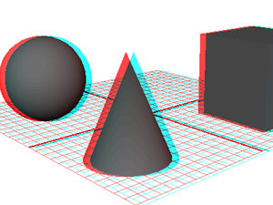
Stereo and cameraSet Node
cameraSet node/command
MFnCameraSet
Function set class to manipulate camera set node
MPxCameraSet
Class for user defined cameraSet node
MCameraSetMessage
Message class to watch operations of adding/removing camera layers
MPx3dModelView
  Add support for setting/querying camera sets

Slide 32
Script Editor auto-completion
The script editor now auto-completes recognized commands and object path names when you enable the Command Completion and Object Path Completion options.
Script Editor:
Command > Command Completion
Command > Object Path Completion
ctrl + space
Command > Show Tooltip Help

Slide 33
Compiler Requirement
Compiler on all platforms:
      Linux 64: gcc 4.1.2
      Leopard 10.5.6+, Xcode 3.1.2
      Windows 32 and 64: Visual Studio 2008 SP1
Maya does not provide binary compatibility between releases

Slide 34
Bug fixes and Miscellaneous changes
Please refer to the “What’s new in API” section in Maya Sherlock documentation
Sherlock Release Candidate 1 available at:
http://adnsparks.autodesk.com/
Notes:
.

Slide 35
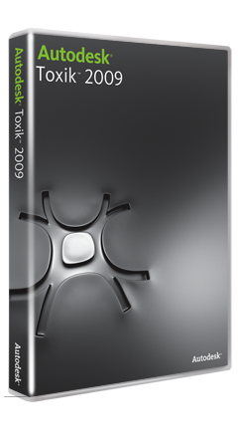
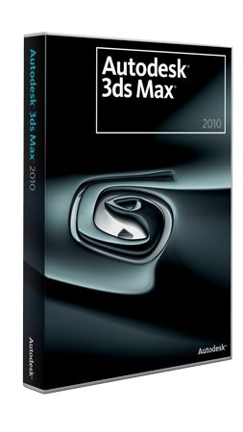
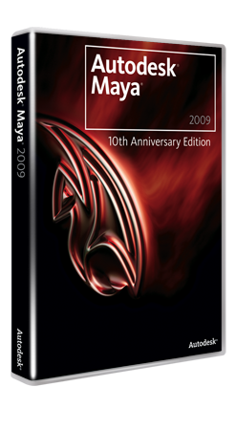

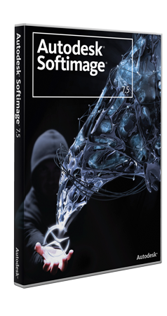
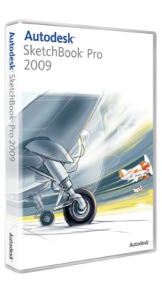
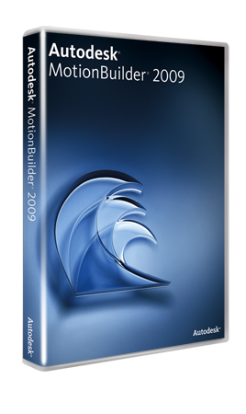
Questions & Answers

